Slide 1
TECH STARTUP
Here is where your presentation begins

Slide 2
CONTENTS OF THIS TEMPLATE
Here’s what you’ll find in this Slidesgo template:
A slide structure based on a presentation of a startup, which you can easily adapt to your needs. For more info on how to edit the template, please visit Slidesgo School or read our FAQs.
An assortment of pictures and illustrations that are suitable for use in the presentation can be found in the alternative resources slide, plus several slides with premium resources.
A thanks slide, which you must keep so that proper credits for our design are given.
A resources slide, where you’ll find links to all the elements used in the template.
Instructions for use.
Final slides with:
The fonts and colors used in the template.
A selection of illustrations. You can also customize and animate them as you wish with the online editor. Visit Storyset by Freepik to find more.
More infographic resources, whose size and color can be edited.
Sets of customizable icons of the following themes: general, business, avatar, creative process, education, help & support, medical, nature, performing arts, SEO & marketing, and teamwork.
You can delete this slide when you’re done editing the presentation.

Slide 3
TABLE OF CONTENTS
01
02
PROBLEM VS. SOLUTION
PRODUCT
03
04
MARKET & COMPETITION
BUSINESS MODEL
Here you could describe the topic of the section
Here you could describe the topic of the section
Here you could describe the topic of the section
Here you could describe the topic of the section

Slide 4
TABLE OF CONTENTS
01
02
PROBLEM VS. SOLUTION
PRODUCT
03
04
MARKET & COMPETITION
BUSINESS MODEL
Here you could describe the topic of the section
Here you could describe the topic of the section
Here you could describe the topic of the section
Here you could describe the topic of the section

Slide 5
“This is a quote, words full of wisdom that someone important said and can make the reader get inspired.”
—SOMEONE FAMOUS

Slide 6
“This is a quote, words full of wisdom that someone important said and can make the reader get inspired.”
—SOMEONE FAMOUS

Slide 7
01
PROBLEM VS. SOLUTION
Here you could describe the topic of the section

Slide 8
01
PROBLEM VS. SOLUTION
Here you could describe the topic of the section

Slide 9
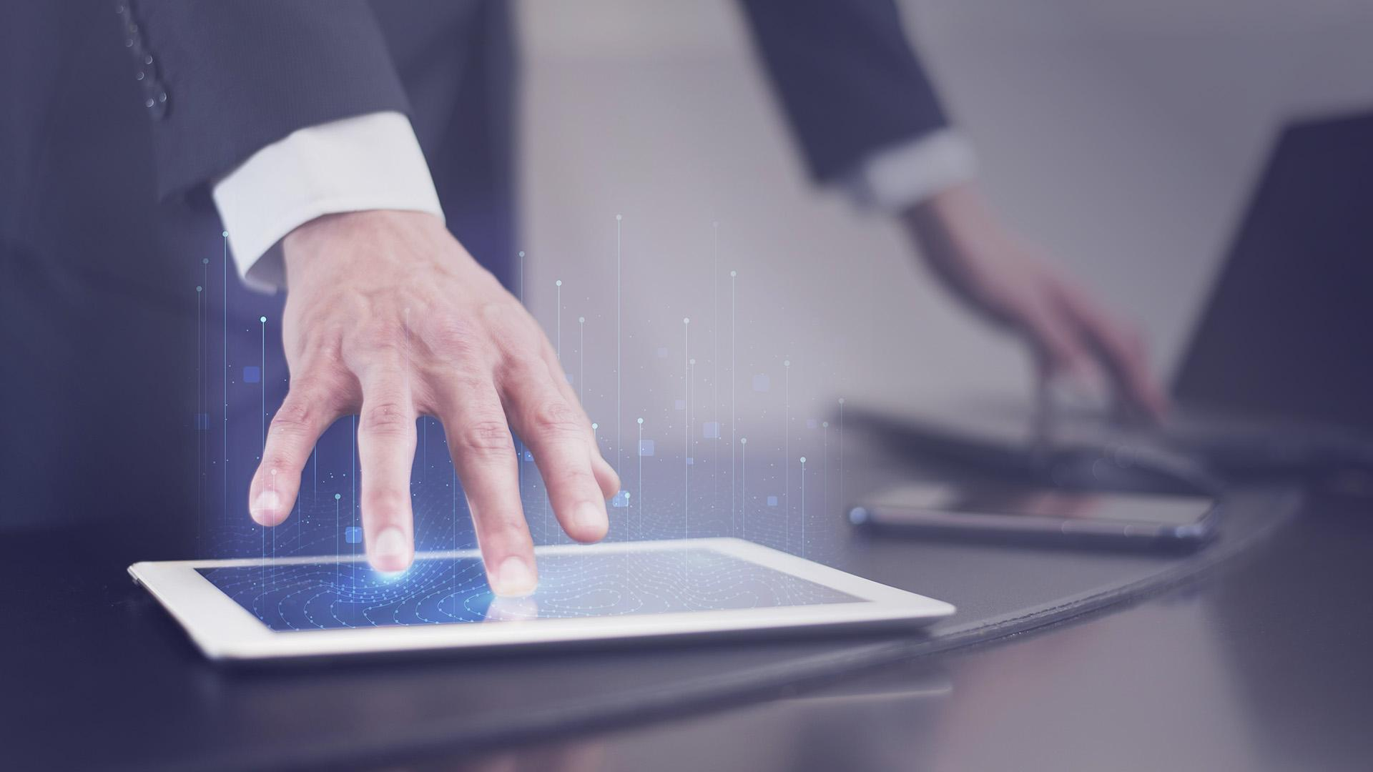
WHOA!
It could be the part of the presentation where you can introduce yourself, write your email…

Slide 10
WHOA!
It could be the part of the presentation where you can introduce yourself, write your email…

Slide 11
INTRODUCTION
Mercury is the closest planet to the Sun and the smallest one in the Solar System—it’s only a bit larger than the Moon. The planet’s name has nothing to do with the liquid metal

Slide 12
INTRODUCTION
Mercury is the closest planet to the Sun and the smallest one in the Solar System—it’s only a bit larger than the Moon. The planet’s name has nothing to do with the liquid metal

Slide 13
OUR COMPANY
YOUR LOGO
Mercury is the closest planet to the Sun and the smallest one in the Solar System—it’s only a bit larger than the Moon. The planet’s name has nothing to do with the liquid metal

Slide 14
OUR COMPANY
YOUR LOGO
Mercury is the closest planet to the Sun and the smallest one in the Solar System—it’s only a bit larger than the Moon

Slide 15
OUR TEAM
JENNA DOE
JOHN PATTERSON
HELENA JAMES
Here you could describe who this person is
Here you could describe who this person is
Here you could describe who this person is

Slide 16
OUR TEAM
JENNA DOE
JOHN PATTERSON
HELENA JAMES
Here you could describe who this person is
Here you could describe who this person is
Here you could describe who this person is

Slide 17
REVIEWING IS GOOD IDEA
MERCURY
MARS
VENUS
JUPITER
SATURN
NEPTUNE
Mercury is the closest planet to the Sun
Despite being red, Mars is a cold place
Venus has a beautiful name, but it’s hot
It’s the biggest planet in the Solar System
Saturn is the ringed one and a gas giant
Neptune is the farthest planet from the Sun

Slide 18
PROBLEM
Mercury is the closest planet to the Sun and the smallest one in the Solar System—it’s only a bit larger than the Moon. The planet’s name has nothing to do with the liquid metal

Slide 19
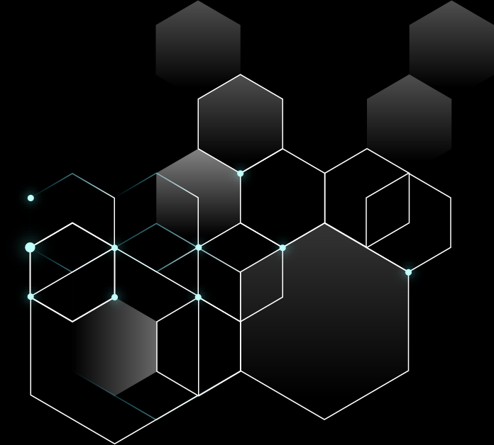
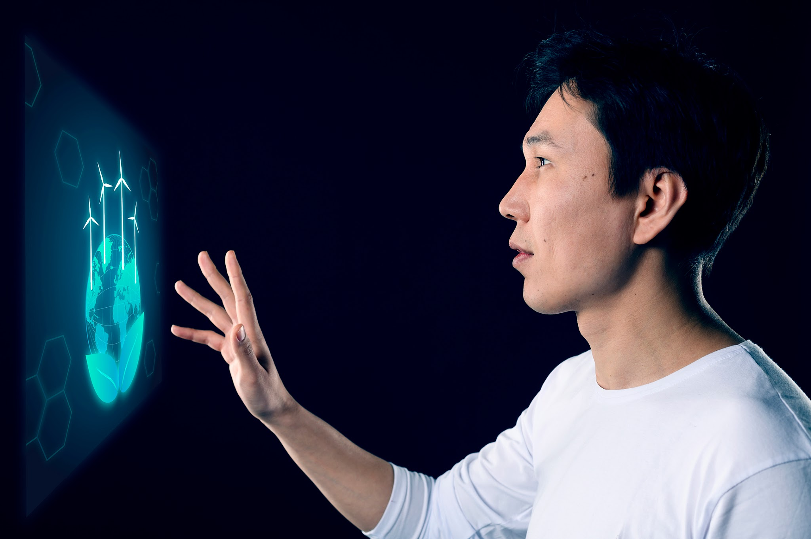
PROBLEM
Mercury is the closest planet to the Sun and the smallest one in the Solar System—it’s only a bit larger than the Moon. The planet’s name has nothing to do with the liquid metal

Slide 20
COMPETITIVE ADVANTAGE
THEM
US
Mercury is the closest planet to the Sun and the smallest one of them all
Venus has a beautiful name and is the second planet from the Sun

Slide 21
THEM
COMPETITIVE ADVANTAGE
US
Mercury is the closest planet to the Sun and the smallest one in the Solar System—it’s only a bit larger than the Moon
Venus has a beautiful name and is the second planet from the Sun. It’s terribly hot—even hotter than Mercury

Slide 22
SOLUTION
Venus has a beautiful name and is the second planet from the Sun. It’s terribly hot—even hotter than Mercury

Slide 23
SOLUTION
Venus has a beautiful name and is the second planet from the Sun. It’s terribly hot—even hotter than Mercury

Slide 24
SWOT ANALYSIS
S
W
O
T
STRENGTHS
WEAKNESSES
OPPORTUNITIES
THREATS
Jupiter is the biggest planet in the Solar System
Venus has a beautiful name, but it’s hot
Neptune is the farthest planet from the Sun
Mercury is the smallest planet of them all

Slide 25
SWOT ANALYSIS
WEAKNESSES
THREATS
S
Venus has a beautiful name, but it’s hot
O
Mercury is the smallest planet of them all
w
T
STRENGTHS
OPPORTUNITIES
Jupiter is the biggest planet in the Solar System
Neptune is the furthest planet from the Sun

Slide 26
SWOT ANALYSIS
S
W
O
T
STRENGTHS
WEAKNESSES
OPPORTUNITIES
THREATS
Jupiter is the biggest planet in the Solar System
Venus has a beautiful name, but it’s hot
Neptune is the furthest planet from the Sun
Mercury is the smallest planet of them all

Slide 27

A PICTURE IS WORTH A THOUSAND WORDS

Slide 28
PRODUCT OVERVIEW
VENUS
NEPTUNE
Venus has a beautiful name
Neptune is the farthest planet
MERCURY
JUPITER
Mercury is the smallest planet
Jupiter is the biggest planet

Slide 29
PRODUCT OVERVIEW
MERCURY
NEPTUNE
JUPITER
VENUS
Mercury is the smallest planet
Neptune is the farthest planet
Jupiter is the biggest planet
Venus has a beautiful name

Slide 30
PLANS
You can explain your
product or your service
You can explain your
product or your service
You can explain your
product or your service
BASIC
PRO
PREMIUM

Slide 31
PLANS
BASIC
PRO
PREMIUM
You can explain your
product or your service
You can explain your
product or your service
You can explain your
product or your service
150
200
250

Slide 32
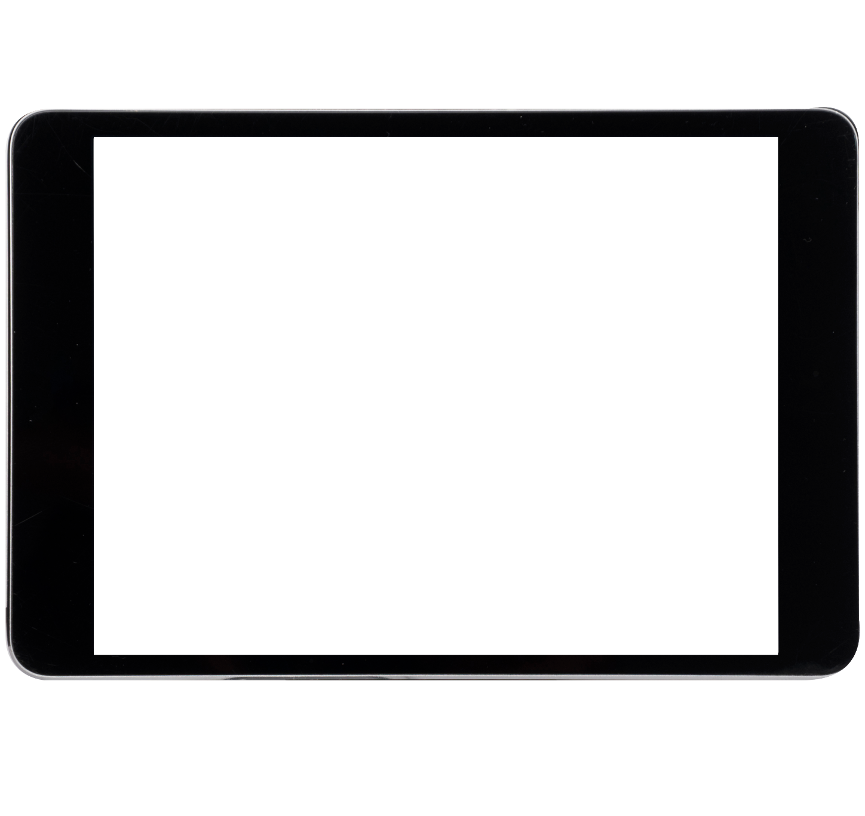
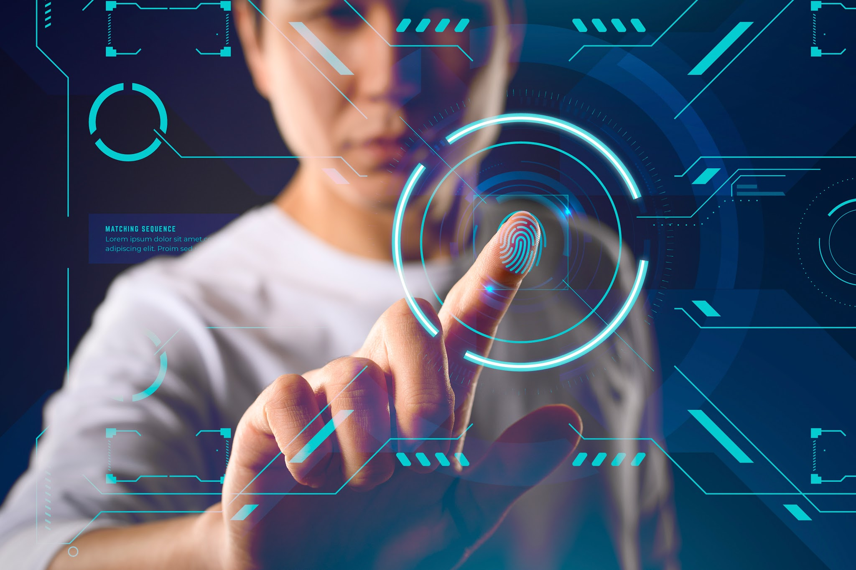
DEMO
Insert your multimedia content here Images reveal large amounts of data

Slide 33
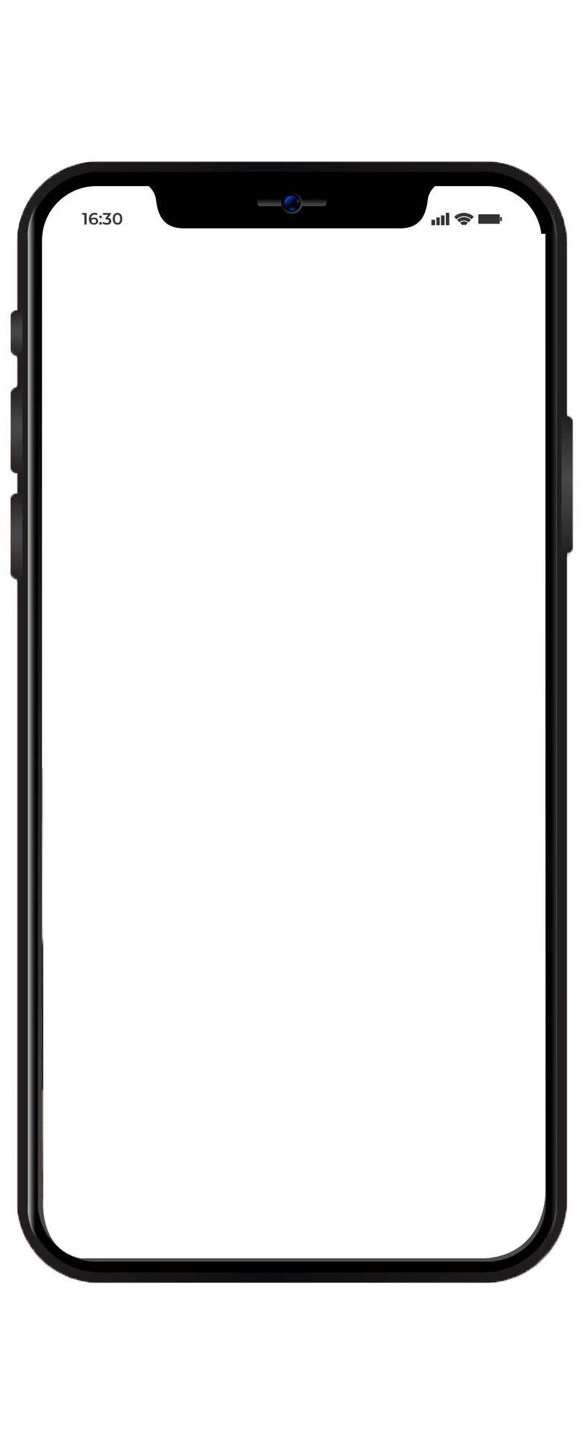
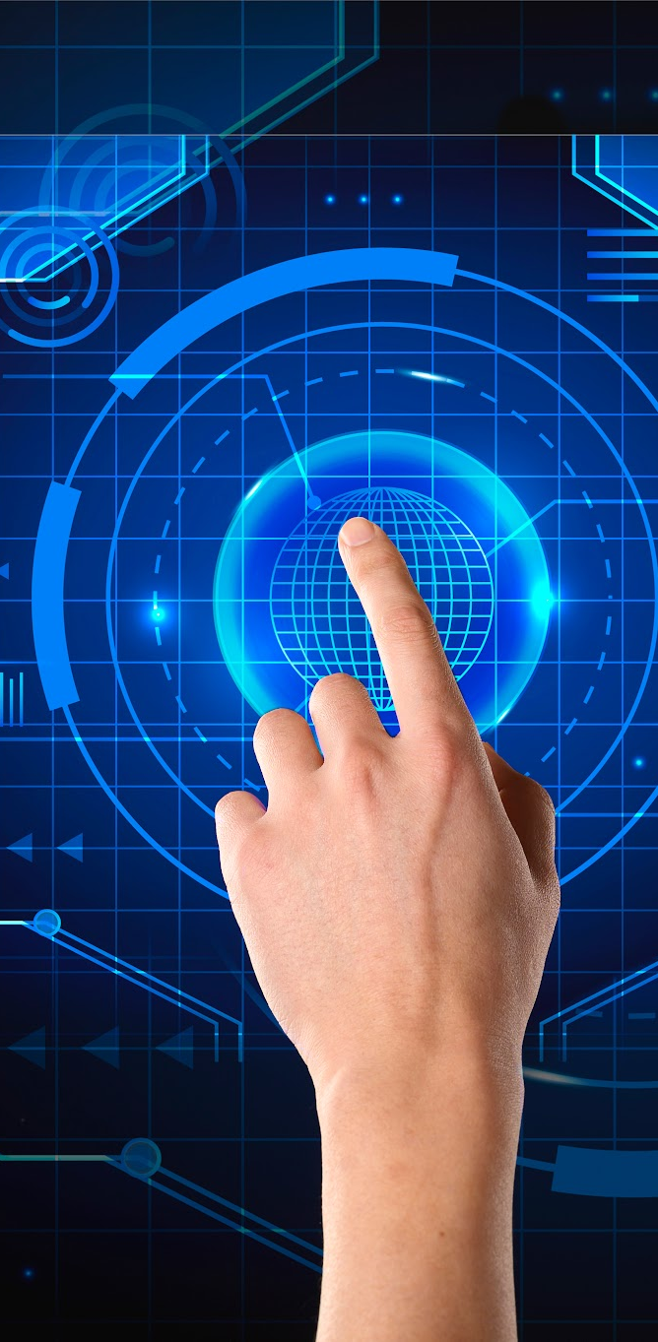
DEMO
Insert your multimedia content here Images reveal large amounts of data

Slide 34
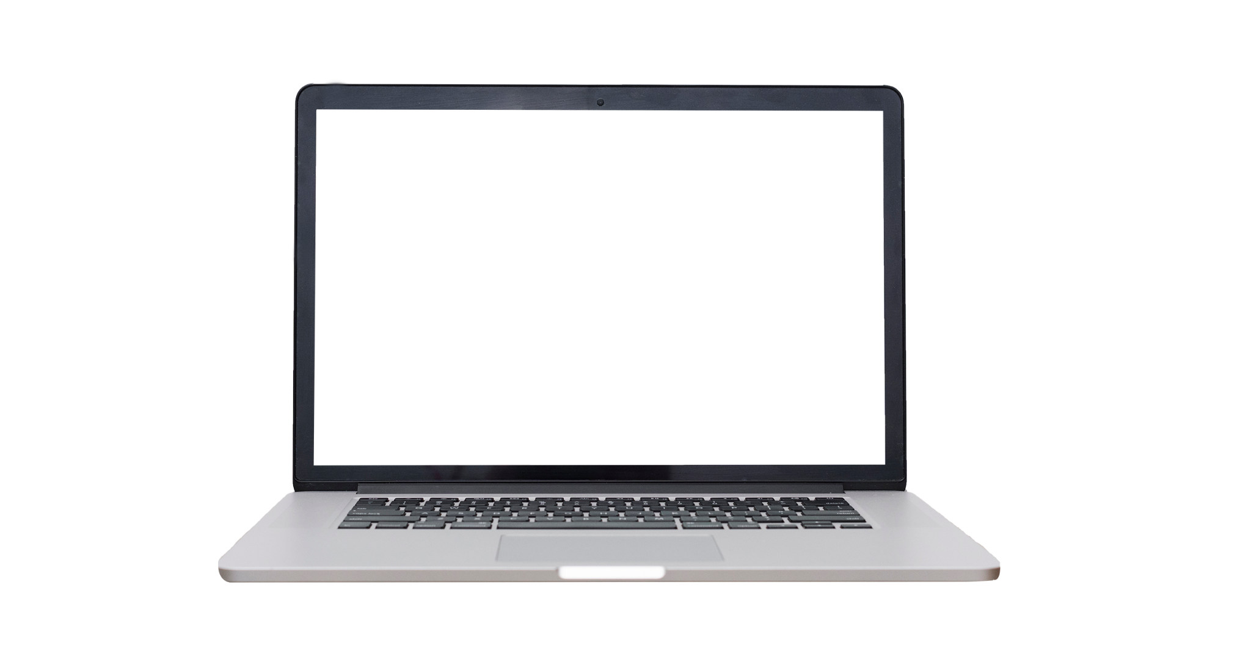
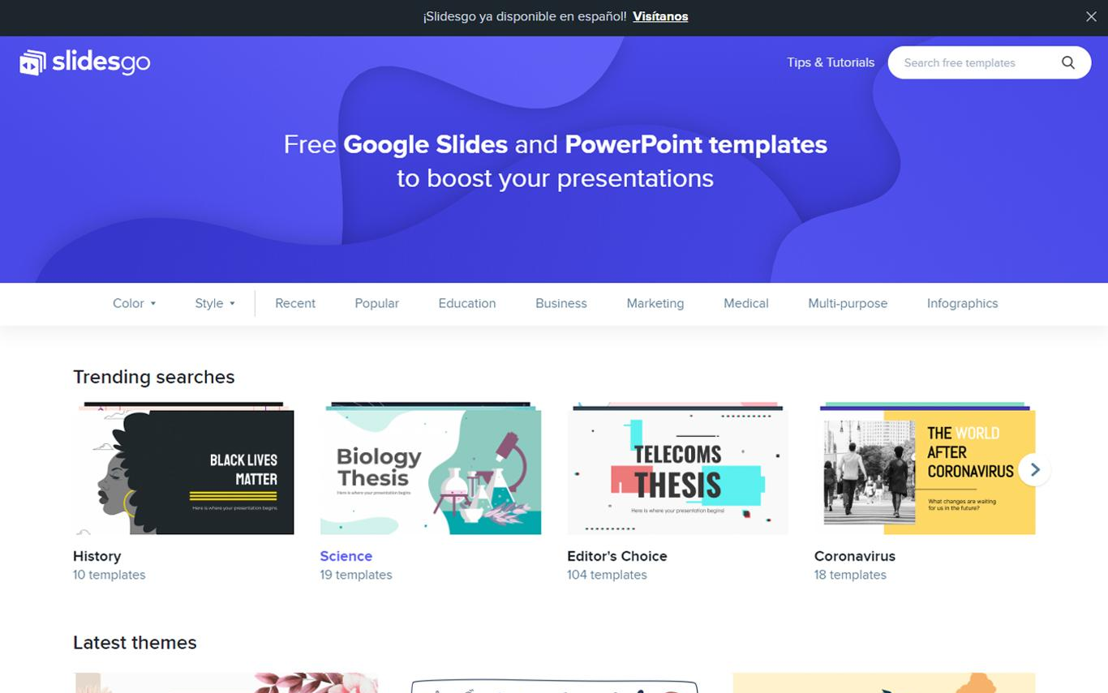
DEMO
Insert your multimedia content here Images reveal large amounts of data

Slide 35

TRACTION
$150,000
$1,000
12,000
2,200
15
Revenue in 2017-2018
Average user savings
Registered businesses
Daily number of users
Total app downloads
To modify this graph, click on it, follow the link, change the data and paste the new graph here

Slide 36
TRACTION
$150,000
2,200
140,000
12,000
Gross revenue for download concept
Registered businesses
only in the West Coast
Daily number of users
connected to our app
Total app downloads
in just one week
To modify this graph, click on it, follow the link, change the data and paste the new graph here, replacing this one

Slide 37
CASE STUDY
CHALLENGE
Neptune is the farthest planet from the Sun
SOLUTION
Despite being red, Mars is a very cold place
RESULTS
Venus has a beautiful name, but it’s terribly hot

Slide 38
CASE STUDY
CHALLENGE
RESULTS
Venus has a beautiful name, but it’s terribly hot
Neptune is the farthest planet from the Sun
SOLUTION
Despite being red, Mars is a cold place

Slide 39
REVIEWS
CLIENT 1
CLIENT 3
HELENA JAMES, 21
CLIENT 2
JOHN PATTERSON, 33
“It’s the biggest planet in the Solar System”
“Saturn is composed mostly of hydrogen and helium”
JENNA DOE, 52
“Jupiter is the biggest planet in the Solar System”

Slide 40



REVIEWS
HELENA JAMES, 21
JOHN DOE, 52
JOHN PATTERSON, 33
“It’s the biggest planet in the Solar System”
“Jupiter is the biggest planet in the Solar System”
“Venus is the second planet from the Sun”

Slide 41
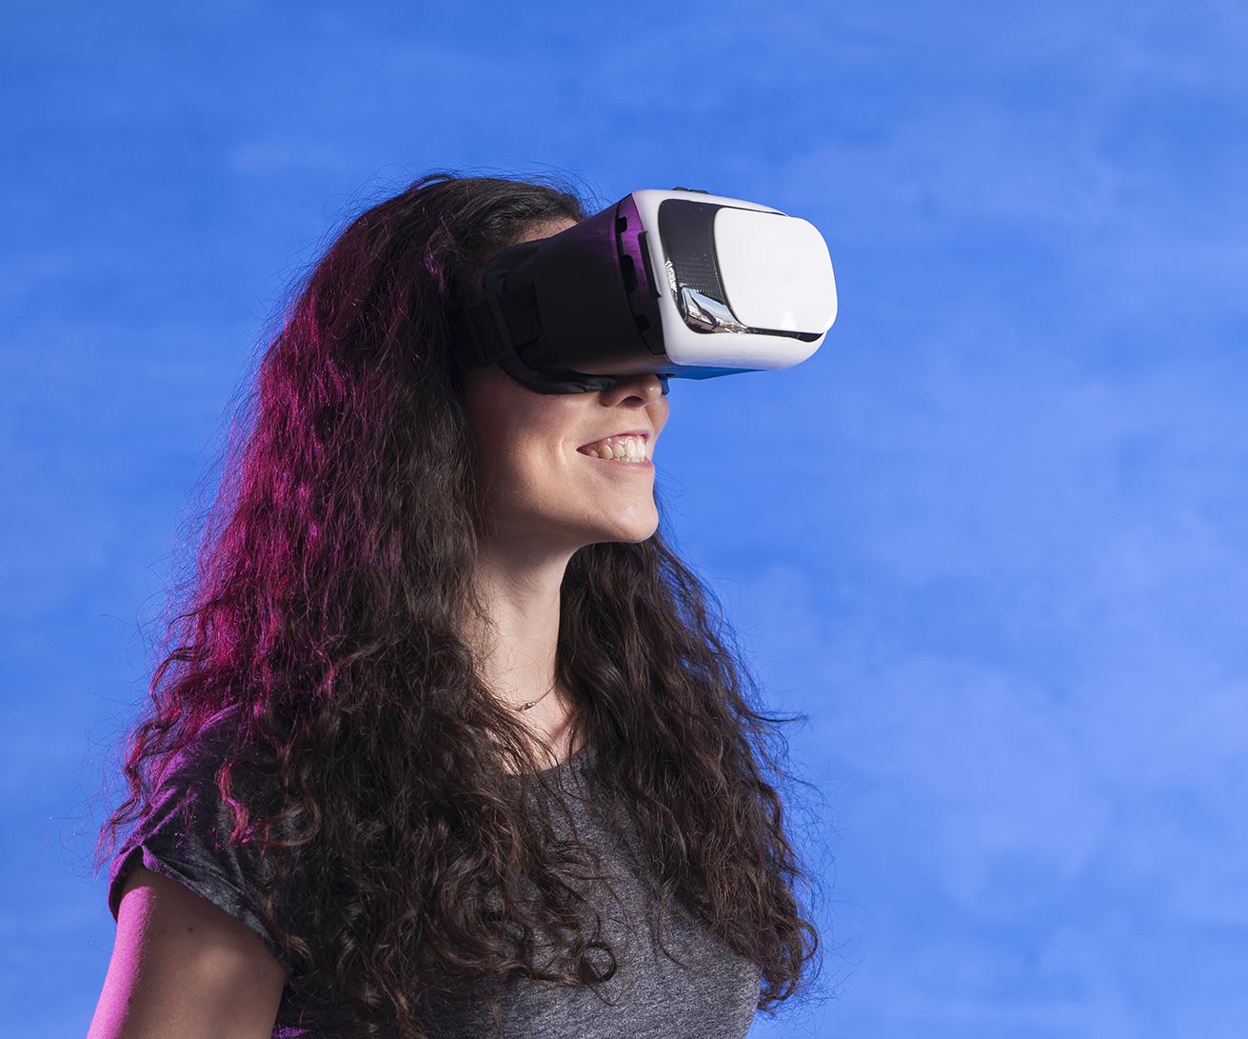
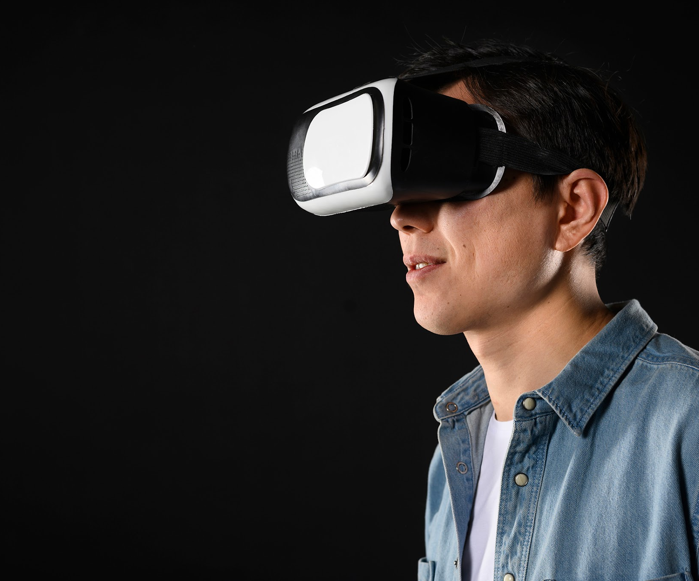
OUR TEAM
JANE DOE
JOHN DOE
You can replace the
image on the screen
with your own
You can replace the
image on the screen
with your own

Slide 42
AWARDS
MERCURY
VENUS
JUPITER
MARS
Here you could talk about this achievement
Here you could talk about this achievement
Here you could talk about this achievement
Here you could talk about this achievement

Slide 43
AWARDS
MERCURY
JUPITER
VENUS
MARS
Here you could talk about this achievement
Here you could talk about this achievement
Here you could talk about this achievement
Here you could talk about this achievement

Slide 44
AWARDS
2017
2018
2019
2020
Here you could talk about this achievement
Here you could talk about this achievement
Here you could talk about this achievement
Here you could talk about this achievement

Slide 45
MARKET SIZE
45%
18%
30%
VENUS
Venus has a beautiful name, but it’s hot
MARS
MERCURY
Jupiter is the biggest planet of them all
Neptune is the farthest planet from the Sun

Slide 46
MARKET SIZE
50
VENUS
30
MERCURY
25
JUPITER
15
SATURN
Jupiter is the biggest planet
Venus has a beautiful name
Neptune is the farthest planet
Mercury is the smallest one

Slide 47
MARKET SIZE
75%
40%
30%
15%
VENUS
MERCURY
SATURN
MARS
Jupiter is the biggest planet
Venus has a beautiful name
Neptune is the furthest planet
Mercury is the smallest one

Slide 48
TARGET
40%
60%
$50.00
GENDER
AVERAGE SPEND PER CUSTOMER
AGE
INTEREST
20-35
40%
READING
WRITING
36-55
60%
TRAVELING

Slide 49
TARGET
GENDER
INTEREST
40%
60%
Venus is the second planet from the Sun”
READING
AVERAGE SPEND PER CUSTOMER
Jupiter is the biggest planet of them all
WRITING
$50.00
Neptune is the farthest planet from the Sun
TRAVELING

Slide 50
4,498,300,000
Big numbers catch your audience’s attention

Slide 51
4,498,300
Big numbers catch your audience’s attention

Slide 52
COMPETITORS
NEPTUNE
MARS
MERCURY
Neptune is the farthest planet
Mars is a very cold place
Mercury is the smallest planet

Slide 53
COMPETITORS
1
2
3
NEPTUNE
MARS
MERCURY
Neptune is the farthest planet
Despite being red, Mars is cold
Mercury is the smallest planet

Slide 54
BUSINESS MODEL
MARKETING
TRAINING
ASSESSMENT
TECHNOLOGY
Jupiter is the biggest planet
Venus has a beautiful name
Neptune is the farthest planet
Mercury is the smallest one

Slide 55
BUSINESS MODEL
ASSESSMENT
TRAINING
MARKETING
Neptune is the farthest planet
Venus has a beautiful name
Despite being red, Mars is cold
PERCENTAGE
TECHNOLOGY
Mercury is the smallest one
Jupiter is the biggest planet

Slide 56
TIMING
DAY 1
Jupiter is the biggest planet
DAY 3
DAY 2
Despite being red, Mars is cold
Venus has a beautiful name
DAY 4
DAY 5
Mercury is the smallest planet
Neptune is very far away

Slide 57
TIMING
MARS
VENUS
Despite being red, Mars is very cold
DAY 1
DAY 2
Venus has a beautiful name
MERCURY
NEPTUNE
Mercury is the smallest planet
DAY 3
DAY 4
Neptune is the fourth-largest

Slide 58
TIMING
DAY 1
DAY 2
DAY 3
DAY 4
Mercury is the closest planet to the Sun and the smallest one
Venus has a beautiful name and is the second planet
Despite being red, Mars is actually a very cold place
Neptune is the fourth-largest planet in the Solar System

Slide 59
PREDICTED GROWTH
Jupiter is a gas giant and the biggest planet of them all
Neptune is the farthest planet from the Sun
Venus has a beautiful name, but it’s terribly hot
Despite being red, Mars is actually a cold place

Slide 60
PREDICTED GROWTH
JUPITER
Jupiter is a gas giant and the biggest planet
VENUS
Venus has a beautiful name, but it’s hot
NEPTUNE
Neptune is the farthest planet from the Sun
MARS
Despite being red, Mars is a cold place

Slide 61

INVESTMENT
40%
30%
MERCURY
JUPITER
Mercury is the smallest planet of them all
Jupiter is the biggest planet of them all
20%
10%
VENUS
SATURN
Venus is the second planet from the Sun
Saturn is a gas giant and has rings
To modify this graph, click on it, follow the link, change the data and paste the new graph here

Slide 62
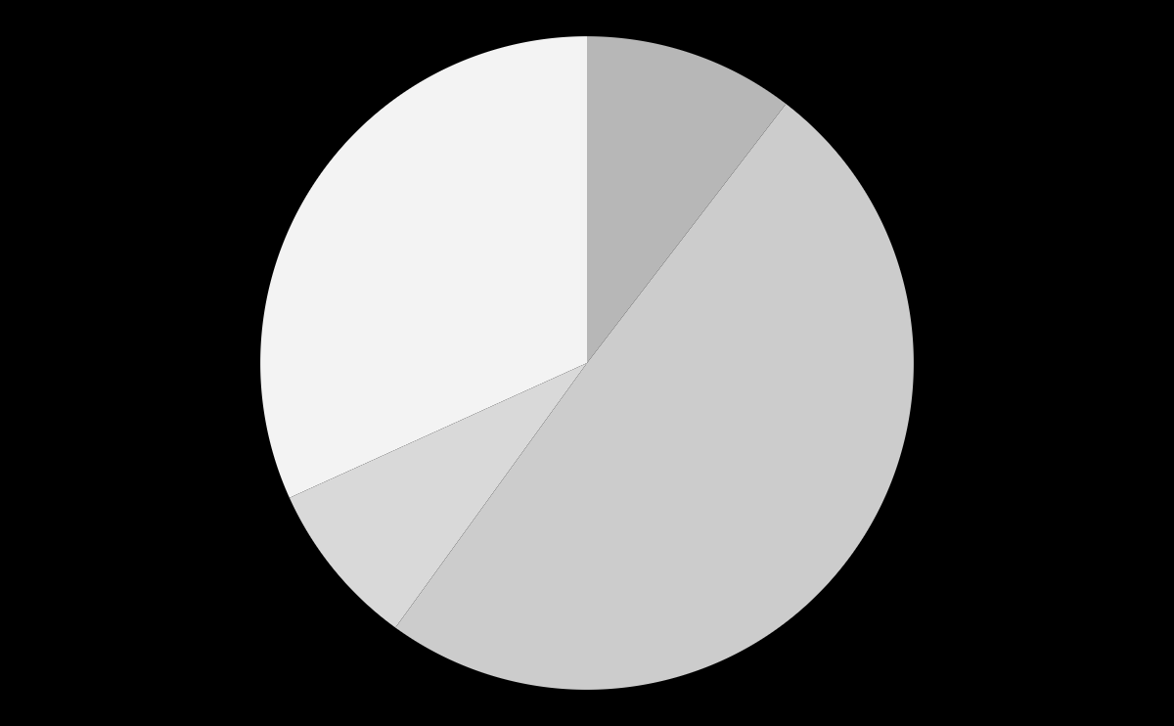
INVESTMENT
MERCURY
31%
JUPITER
Mercury is the smallest planet
10%
Jupiter is the biggest planet
VENUS
SATURN
Venus has a beautiful name
Saturn is a gas giant and has rings
10%
49%
To modify this graph, click on it, follow the link, change the data and paste the new graph here

Slide 63
THIS IS A TABLE
AREA | DESCRIPTION | PRICE
TRAINING | Venus has a beautiful name and is the second planet from the Sun
MARKETING | Mercury is the closest planet to the Sun and the smallest one in the Solar System
ASSESSMENT | Despite being red, Mars is actually a cold place full of iron oxide dust
TECHNOLOGY | Saturn, the ringed planet, is composed mostly of hydrogen and helium

Slide 64
TABLES
TRAINING | Mercury is the smallest planet of them all
MARKETING | Venus is the second planet from the Sun
ASSESSMENT | It’s the biggest planet in the Solar System
TECHNOLOGY | Despite being red, Mars is cold
TRAINING | Saturn is the ringed one and a gas giant
MARKETING | Neptune is very far away from Earth

Slide 65
THANKS
Do you have any questions?
addyouremail@freepik.com
+91 620 421 838
yourcompany.com
Please keep this slide for attribution

Slide 66
RESOURCES
PHOTOS
Top view smartphone mockup with headphones
Close-up man using smart touch screen server
Businessman-working-on-laptop

Slide 67
PREMIUM RESOURCES
PHOTOS
Business-man-using-laptop
Technology background texture
Woman playing games on vr set copy space
Notebook sitting on floor mockup
Close-up tablet above laptop mockup
Notebook and diary open workspace on desk
Front view of businessman using hi-tech tablet
Happy-employee with tablet Premium
Side view of businessman using technology on tablet

Slide 68
PREMIUM RESOURCES

Slide 69
ALTERNATIVE PREMIUM RESOURCES
PHOTOS
Front view of businessman and technology
Smiling businessman with hi-tech hologram

Slide 70
ALTERNATIVE PREMIUM RESOURCES
VECTORS
Technology background with abstract hud
Futuristic technology infographic
Futuristic hexagonal background
Abstract futuristic background concept

Slide 71
PREMIUM ALTERNATIVE RESOURCES

Slide 72
Instructions for use
In order to use this template, you must credit Slidesgo by keeping the Thanks slide.
You are allowed to:
- Modify this template.
- Use it for both personal and commercial projects.
You are not allowed to:
- Sublicense, sell or rent any of Slidesgo Content (or a modified version of Slidesgo Content).
- Distribute Slidesgo Content unless it has been expressly authorized by Slidesgo.
- Include Slidesgo Content in an online or offline database or file.
- Offer Slidesgo templates (or modified versions of Slidesgo templates) for download.
- Acquire the copyright of Slidesgo Content.
For more information about editing slides, please read our FAQs or visit Slidesgo School:
https://slidesgo.com/faqs and https://slidesgo.com/slidesgo-school

Slide 73
Instructions for use (premium users)
In order to use this template, you must be a Premium user on Slidesgo.
You are allowed to:
Modify this template.
Use it for both personal and commercial purposes.
Hide or delete the “Thanks” slide and the mention to Slidesgo in the credits.
Share this template in an editable format with people who are not part of your team.
You are not allowed to:
Sublicense, sell or rent this Slidesgo Template (or a modified version of this Slidesgo Template).
Distribute this Slidesgo Template (or a modified version of this Slidesgo Template) or include it in a database or in any other product or service that offers downloadable images, icons or presentations that may be subject to distribution or resale.
Use any of the elements that are part of this Slidesgo Template in an isolated and separated way from this Template.
Register any of the elements that are part of this template as a trademark or logo, or register it as a work in an intellectual property registry or similar.
For more information about editing slides, please read our FAQs or visit Slidesgo School:
https://slidesgo.com/faqs and https://slidesgo.com/slidesgo-school

Slide 74
Fonts & colors used
This presentation has been made using the following fonts:
Roboto Squada One
(https://fonts.google.com/specimen/Squada+One)
Roboto Condensed
(https://fonts.google.com/specimen/Roboto+Condensed)
#88d3ce
#073763
#423864
#0b5394
#ffffff
#3d85c6
#efefef
#9ba2ff
#d9d9d9
#00d6c0
#cccccc

Slide 75
Use our editable graphic resources...
You can easily resize these resources without losing quality. To change the color, just ungroup the resource and click on the object you want to change. Then, click on the paint bucket and select the color you want. Don’t forget to group the resource again when you’re done.

Slide 77
...and our sets of editable icons
You can resize these icons without losing quality.
You can change the stroke and fill color; just select the icon and click on the paint bucket/pen.

Slide 78
Business Icons

Slide 79
Avatar Icons

Slide 80
Creative Process Icons

Slide 81
Educational Process Icons

Slide 82
Help & Support Icons

Slide 83
Medical Icons

Slide 84
Nature Icons

Slide 85
Performing Arts Icons

Slide 86
SEO & Marketing Icons

Slide 87
Teamwork Icons

Slide 88


